Slide 1
Chemical Hygiene
A.R. Smith Department of Chemistry
Samuella B. Sigmann, NRCC CHO
April 1th, 2008

Slide 2
Progress From 2005
✓
Test eyewashes and showers (on going)
Remove all time-sensitive chemicals that are out of date (on going)
Test time-sensitive chemicals (on going)
Complete individual inventories
Inspections (on going)
Better signage
Decide as a department on a uniform labeling system
Centralized procurement
✓
✓
✓
✓
✓
?
x

Slide 3
Training Topics Today
Safety Culture
Accident Causation & Prevention
Preventing Exposure
Spills
Methods of Detection
Signs & Symptoms
Solvents
Storage & Handling
Medical Emergencies
Miscellaneous Information

Slide 4
Is it contagious?
Safety Culture

Slide 5
Culture - Definition
The predominating attitudes and behavior that characterize the functioning of a group or organization.
Development of the intellect through training or education. - Enlightenment resulting from such training or education.
American Heritage® Dictionary

Slide 7
Top 10 lab safety excuses from university professors: (Some actual quotes, others paraphrased with the bad words edited out.)
I know the rules are to wear long pants in the lab, but I am just working at my desk today, and anyway if you would keep the building cooler I wouldn't have to wear shorts.“
Those rules (regulations/laws) don't apply to my lab.
I buy that chemical in bulk and store the extra because I might need more sometime in the future.
I have no idea where all that waste came from.
That's not my stuff. That was in my lab before I got here.
I have to turn off the fume-hood fan because it is too loud.
It was free. XYZ chemical company was going out of business and donated all this stuff to our department.
I've been doing it this way for 20(30/40) years.
I don't have time for this. Safety is common sense, and my research is much more important that teaching my students stuff they should already know.
I thought the lab safety policy only applied to the graduate assistants.
Writing lab operating procedures is like writing instructions for my husband on how to use the vacuum cleaner.
"Cattoor, Larry G" <cattoor@KU.EDU>

Slide 8
Hazard vs. Risk
Hazards are dangers intrinsic to a substance or operation – a potential
Risk refers to the probability of injury associated with working with a substance or carrying out a particular laboratory operation
For a given chemical, risk can be reduced; hazard cannot
For a given process, both can be reduced
Prudent Practices for Handling, Storage, and Disposal of
Chemicals in Laboratories, p.14, National Research Council

Slide 9
Incident vs. Accident
An INCIDENT is
A near miss, or, more nearly correct, a near hit
It has can be called a “lucky accident.”
An ACCIDENT is
An unplanned, unwanted event that disrupts the orderly flow of the work process
It involves the motion (energy) of people, objects, or substances
It is indicated by physical injury and/or property damage
The Accident Weed

Slide 10
However…
An accident is not always unplanned
Through poor system design, poor chemical hygiene, or both, accidents may be unintentionally planned
If intentionally planned…
that’s criminal
The Accident Weed

Slide 11
Accident Causation

Slide 12
Active Cause
Sometimes called “direct” or “surface” cause
Active failures can occur anytime there are individuals are in direct contact with the work process
Active failures can be
Knowledge-based
Rule-based
Skill-based
MERS-TM

Slide 13
Latent Cause
Also referred to as “root” cause
Latent conditions exist because individuals not in direct contact with the work process take actions and/or make decisions that affect technical or organizational policy and procedures or the allocation of resources
Are not “discovered” until after the event
MERS-TM

Slide 14
Injury/Illness
Strains
Burns
Cuts
Active Causes of the Accident
Unguarded machine
Horseplay
Broken tools
Create a hazard
Chemical spill
Ignore a hazard
Conditions
Defective PPE
Fails to report injury
Untrained worker
Fails to inspect
Behaviors
Lack of time
Fails to enforce
To much work
Fails to train
Inadequate training
No recognition
No discipline procedures
Inadequate labeling procedures
No orientation process
Outdated Procedures
Decisions
Inadequate training plan
No recognition plan
No accountability policy
No inspection policy
Latent Causes of the Accident
The Accident Weed

Slide 15
Accident Prevention

Slide 16
Swiss Cheese Model
Accident Barriers
James Reason, Department of Psychology, University of Manchester, Manchester M13 9PL

Slide 17
Organizational
Influences
Latent
Unsafe
Supervision
Latent
Preconditions Exist
For Unsafe Act
Latent/
Active
Unsafe Act
Active
Failed or Missing
Barriers
Accident or
Incident

Slide 18
“If an incident investigation program frequently assigns operator error and inadequate training as root causes, or if the recommendations frequently include disciplining operators or conducting more training, this may be a sign that the program isn’t identifying or addressing the true root causes.”
Recurring Causes of Recent Chemical Accidents
James C. Belk, EPA 1998

Slide 19
“Likewise, if a safety management system relies on properly trained operators to take correct action as the only line of defense against a major disaster, then a facility that employs such a system is asking for trouble in the long run, because
humans make mistakes.”
Recurring Causes of Recent Chemical Accidents
James C. Belk, EPA 1998

Slide 20
Common Themes (Root Causes) Found
Inadequate hazard review or process hazards analysis
Installation of pollution control equipment
Use of inappropriate or poorly designed equipment
Inadequate indications of process condition
Warnings went unheeded
Recurring Causes of Recent Chemical Accidents
James C. Belk, EPA 1998

Slide 21
“If understanding recurring causal factors and root causes is important in learning about accident patterns, it’s perhaps nearly as important to recognize what root causes have not ‘made the list’.”
Training & Operator Error
Recurring Causes of Recent Chemical Accidents
James C. Belk, EPA 1998

Slide 22
Safety Precedence Sequence (Barriers)
Design for Minimum Hazard
Install Safety Devices
Use Safety Warnings
Control with Procedures / Administrative Controls
Personnel Action by Training, Awareness, Knowledge
Accepted Risk
Recurring Causes of Recent Chemical Accidents
James C. Belk, EPA 1998

Slide 23
“For most major chemical accidents, EPA and OSHA believe that it is rarely the action or inaction of a single operator that is the sole or even primary cause of an accident.”
Recurring Causes of Recent Chemical Accidents
James C. Belk, EPA 1998

Slide 24
In a Safety Culture Attitudes & Behaviors
Aim to reduce hazards
Aim to determine risks
Aim to minimize exposure to risk(s)
Are proactive
Strive to share responsibilities
Recognize safety as an equal performance dimension
Strive for improvement

Slide 25
PPE is the last “barrier”
Why?
Because if it fails…
You have an exposure
So?
Don’t depend on PPE to protect you from
Poor Planning

Slide 26
Preventing Exposure

Slide 27
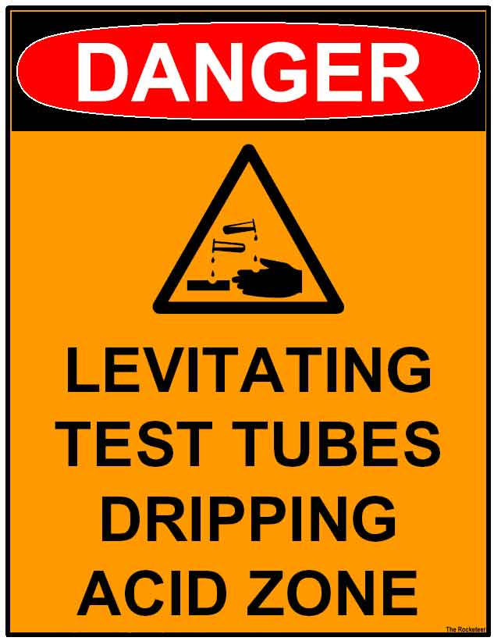

Slide 28
OSHA Standards (Regulatory)
The Fine Print
1910.1450(f)
Employee information and training.
1910.1450(f)(1)
The employer shall provide employees with information and training to ensure that they are apprised of the hazards of chemicals present in their work area.
1910.1450(f)(3)
Information. Employees shall be informed of:

Slide 29
OSHA Standards, cont.
1910.1450(f)(3)(iii)
The permissible exposure limits for OSHA regulated substances or recommended exposure limits for other hazardous chemicals where there is no applicable OSHA standard;
OSHA 29 CFR 1910 Subpart Z – Toxic and Hazardous Substances - Standard 1910.1000 – Air contaminants - There are 3 Tables of hazardous materials, Z1 – Z3
Standards 1910.1001 through 1096 – specifically regulated substances

Slide 30
Permissible Exposure Limit (PEL)
Refers to an employee’s exposure, as a time weighted average, to an air contaminant. It is a concentration that shall not be exceeded in any 8-hour work shift of a 40-hour work week.
1910.1450(c)
Permissible exposure limits. For laboratory uses of OSHA regulated substances, the employer shall assure that laboratory employees' exposures to such substances do not exceed the permissible exposure limits specified in 29 CFR part 1910, subpart Z.

Slide 31
Time Weighted Average (TWA)
Simple to calculate
The term “average” in itself denotes that the limit value has been exceeded at some point
TWA Calculator

Slide 32
What concentration (ppm) of solvent would be created by evaporating ONE MOLE of solvent into the stockroom solvent room?
New solvent room area is ~1120 ft³
1 mole of CH₂Cl₂ would be ~65 mL
At 680 torr and 22ºC, room contains ~1182 moles of air
(1/1182) x 10⁶ = 846 ppm
PEL for CH₂Cl₂ is 500 ppm TWA
C is 1000 ppm
Notes:
Assuming no ventilation, complete mixing – both not realistic

Slide 33
Practicality of PELs
PELs are not a very practical way to determine exposure unless you are monitoring for the hazard
Rarely, if ever, will this apply to work in our labs – why?
NC is a State Plan State – OSHNC PEL standards are stricter for some chemicals
Use as a common sense guide to assist in recognition and control of hazards
According to Prudent Practices, any chemical with a PEL < 50 ppm should only be used in a hood
Notes:
An index of toxicity – LD50 administered as a single dose kills 50 % of the test population

Slide 34
PELs are should not be used as an index of toxicity
All things are poisons, for there is nothing without poisonous qualities...it is only the dose which makes
a thing poison.
Paracelsus

Slide 35
Common OSHA Terms
C – Ceiling Values. An employee's exposure to any substance in Table Z-1, the exposure limit of which is preceded by a "C", shall at no time exceed the exposure limit given for that substance.
Action Level – Indicates the level of a hazard at which medical surveillance or chemical monitoring is triggered – they are often set at one half the PEL

Slide 36
IDHL – Immediately dangerous to life or health means an atmospheric concentration of any toxic, corrosive or asphyxiant substance that poses an immediate threat to life or would interfere with an individual's ability to escape from a dangerous atmosphere.

Slide 37
Other Agency Acronyms
REL – Recommended Exposure Limit – a NIOSH term
TLV – Threshold Limit Value which is the ACGIH form of the PEL and it is not necessarily the same concentration – It represents the conditions under which it is believed nearly all workers may be repeatedly exposed to w/o adverse effects
STEL - Short Term Exposure Limit a 15-minute TWA which should not be exceeded at any time during a working day, even if the 8-hour time-weighted average is within the TLV (OSHA also uses this one)
OEL – Occupational Exposure Limit – an industry consensus value
Notes:
. It is designed to protect workers from chemicals which may cause irritancy, chronic or irreversible tissue damage, or narcosis which may increase the likelihood of accidental injury. For Threshold Limit - Ceiling Values (TLV-C) the concentration should not be exceeded during any part of the working day.
National Institute of Occupational Safety & Health

Slide 38
Spills

Slide 39
For our purposes, a “small” spill is one that can easily be controlled and cleaned up by one person
If the spill is large, and the hazard great, evacuate the area and/or building and call 8000 to activate “HAZMAT” team
Provide emergency personnel with relevant information. (chemical, amount, known hazards, etc.)
Control foot traffic & canvas as exiting to get people out of the area
Remove, turn off, avoid any spark sources
Do NOT pull the fire alarm
If you believe that you have been exposed to a chemical above the acceptable limit during a spill or other uncontrolled situation, seek medical attention
Resource Manual
Notes:
Chemical Spills
The following procedures are to be used in responding to chemical spills that can not be safely contained by persons working in the area.
Indoor Spills
• If the spill represents a hazard that is immediately dangerous to life or health (IDLH), evacuate the room/area, and, if in doubt, evacuate the building.
• Contact University Police (262-8000) and request assistance. Describe the situation and indicate if there is a potential for fire or explosion, or if injuries exist. University Police will contact the Safety & Workers' Compensation Office and Physical Plant Hazardous Waste Office for assistance. Be prepared to provide a description of the spilled substance and a Material Safety Data Sheet, if possible.
• The area of the spill should be sealed off or secured to prevent students or employees from entering the danger zone.
• From a safe location, provide directions to and information about the spill zone to University Police and other emergency response personnel as needed.

Slide 40
Where to Find Information
2004 North American Emergency Response Guidebook
For ER personnel, but lots of useful info
Available in PDF format also
Gives ER info for fire and spill
In most all cases our spills would be considered small (<200 L)
OSHA 29 CFR 1910 120
Hazardous Waste Operations and Emergency Response (HAZWOPER)

Slide 41
1910.1450(f)(4)(i)(A)
Methods of Detection

Slide 42
Warning Properties – Smell
Some compounds have good warning properties which means that they can be detected in air due to their odor, or they induce a mild irritation at levels below which they are toxic.
You should know the early warning properties (or lack thereof) for the hazardous chemicals in your lab.

Slide 43
Smell
Odor is not necessarily an adequate early warning property for many substances
For example, methylene chloride has an odor threshold of 250 ppm - 10 times higher than the PEL, which is 25 ppm)
For many chemicals, olfactory fatigue can occur at high concentrations
Many organic solvent vapors are heavier than air and could cause asphyxiation in enclosed, poorly ventilated, or low-lying areas
ATSDR

Slide 44
Children & Exposure
Children in the same area of an exposure as an adult may receive larger doses of the chemical because they have greater lung surface area to body weight ratios and increased minute volumes:weight ratios.
Additionally, they may be exposed to higher levels than the adults in the same location because of their short stature and the higher levels of organic vapors found nearer to the ground.”
ATSDR

Slide 45
1910.1450(f)(3)(iv)
Signs & Symptoms

Slide 46
Signs
Are external
Are visible to self and others
Manifest as
Watery eyes
Sneezing, coughing
Change in breathing rate
Change in skin
Redness, whitening
Scratching, flaking
Swelling

Slide 47
Symptoms
Are internal
Not observable
Are subjective
Headache
Irritation to nose
Damage to organs
Dizziness

Slide 48
Where to Find Information
http://toxnet.nlm.nih.gov/
hazmap
search ChemID Plus
Webwiser – show levels
Show HSDB
ATSDR MMGs
Show Toxmap
Show Scorecards - EPA
Notes:
http://toxnet.nlm.nih.gov/
methylene chloride
hazmap
search ChemID Plus
Webwiser – show levels
Show HSDB
Show Toxmap
Show Scorecards - EPA

Slide 49
Solvents

Slide 50
Storage
Maximum 60 gallons (227 L) of Class IA, IB and IC flammable liquids and Class II combustible liquids may be stored in a single storage cabinet. Not more that 120 total gallons of flammable and combustible liquids may be stored in a single storage cabinet.
Maximum three (3) approved storage cabinets* may be located in a single fire area; additional cabinets may be located in same fire area if additional cabinet, or group of three cabinets, is separated from other cabinets, or group of cabinets, by at least 100 feet (30 m).*
In a sprinklered building, this may be doubled to six (6)
Procedure 3 - Flammable and Combustible Materials
Notes:
240 liter (12 20 L cans) = 63.401 292 565 92 gallon [US, liquid]

Slide 51
Flammable Liquids - IA, IB, IC Combustible Liquids - II, III
Container Type | IA | IB | IC | II | III
Glass | 1pt | 1pt | 1gal | 1gal | 5gal
Metal* or Approved Plastic | 1gal | 5gal | 5gal | 5gal | 5gal
Safety Cans | 2gal | 5gal | 5gal | 5gal | 5gal
Metal Drums** | 60gal | 60gal | 60gal | 60gal | 60gal
Polyethylene*** | 1gal | 5gal | 5gal
* Metal refers to containers other than DOT drums.
** Metal Drums refers to DOT Spec. containers.
*** Polyethylene containers are DOT Spec. 34, or others as authorized by DOT Exemption.
Procedure 3 - Flammable and Combustible Materials
Notes:
Metal refers to containers other than DOT drums.
**Metal Drums refers to DOT Spec. containers.
***Polyethylene containers are DOT Spec. 34, or others as authorized by DOT Exemption.
Notes :
DOT Type III polyethylene non-reusable containers, constructed and tested in accordance with DOT specifications 2U, treated if necessary to prevent permeation, may be used for storage of Class II and Class III liquids, in all capacities not to exceed 2½ gallons (9.5 L).
Class IA and Class IB liquids may be stored in glass containers of not more than one (1) gallon capacity if the required liquid purity (such as ACS analytical reagent grade or higher) would be affected by storage in metal containers, or if the liquid would cause excessive corrosion of the metal container.
"NO SMOKING" signs must be observed at all times. Containers are to be labeled "DANGER - FLAMMABLE - KEEP AWAY FROM HEAT, SPARKS, AND OPEN FLAMES. KEEP CONTAINER CLOSED WHEN NOT IN USE."

Slide 52
DOT Type III polyethylene non-reusable containers may be used for storage of Class II and Class III liquids, in all capacities not to exceed 2½ gallons (9.5 L).
Class IA and Class IB liquids may be stored in glass containers of not more than one (1) gallon capacity if the required liquid purity would be affected by storage in metal containers, or if the liquid would cause excessive corrosion of the metal container.
Containers are to be labeled "DANGER - FLAMMABLE - KEEP AWAY FROM HEAT, SPARKS, AND OPEN FLAMES. KEEP CONTAINER CLOSED WHEN NOT IN USE."
Procedure 3 - Flammable and Combustible Materials

Slide 53
Flash Point | Boiling Point | NFPA 30 Class | NFPA 704 Flammability
<23 | <38 | IA | 4
<23 | ≥38 | IB | 3
>23 & <38 | any | IC
≥38 & <60 | any | II | 2
≥60 & <93 | any | IIIA
≥93 | any | IIIB | 1
4 Class 1A materials, or those which will vaporize and/or disperse and burn readily in air
3 Class 1B and 1C materials, also readily ignited liquids and solids
2 Class II and IIIA materials, also solids and semi-solids that readily emit flammable vapors.
1 Class IIIB materials. Almost all combustible vapors. Materials that must be preheated before combustion
0 Materials that will not burn when exposed to temperature of 1500o F for > 5 minutes

Slide 54
The quantity of flammables on hand in a unit must be kept to a minimum. Only in unusual circumstances will the maximum quantities be permitted. The following guidelines were adopted by the State of North Carolina for use in State agencies on the recommendation of the Deputy Commissioner of Insurance:
ASU Resource Manual

Slide 55
If a one (1) gallon quantity of one specific liquid represents more than a thirty (30) day supply of a Class IA and IB flammable liquid, smaller quantities should be purchased.
Multiple cans and/or bottles of any one specific flammable liquid will not be permitted in a unit in open storage or storage cabinet if it represents more than a five (5) day supply of the flammable product.
Quantities stored inside storage rooms are not to exceed a thirty (30) day supply for that building.
ASU Resource Manual

Slide 56
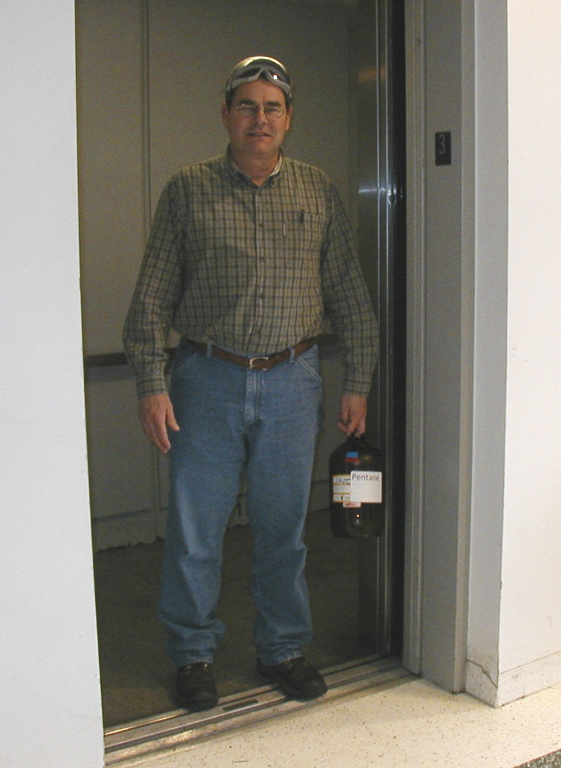
PPE
No goggles
No gloves
Use stairs
not elevator
NFPA 4 Rating
therefore
Transport
chemicals
w/ secondary
containers
glass container
Is too large

Slide 57
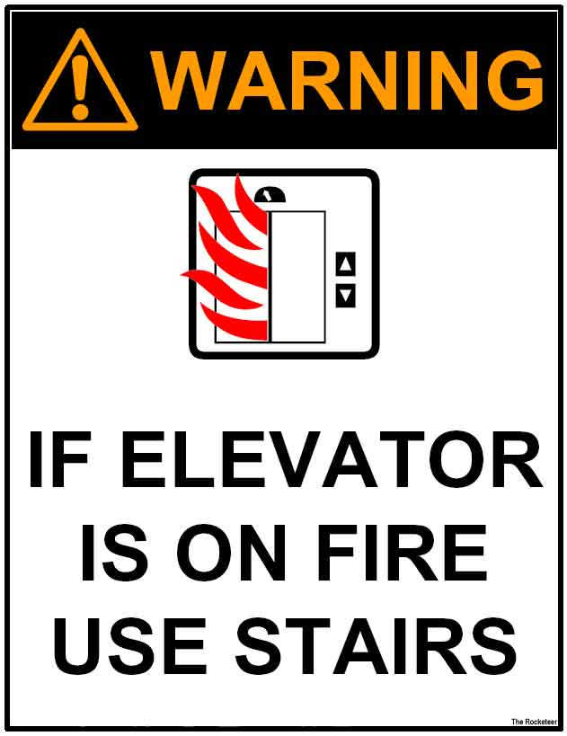

Slide 58
Assisting the Injured or Ill
Medical Emergencies

Slide 60
Protocol for Injured or Ill Persons Assume…
that the injury/illness is on campus – important for ensuring that the phone number given here is the correct one
that the injury/illness is work related (worker’s comp) if injured/ill person is an employee
that only the injured/ill person involved in the emergency

Slide 61
Life Threatening – Students, Employees, and Visitors
Call (or have someone call) emergency personnel and stay on the line
From campus phone, dial 9-911
From personal cell phone 911
Do not move the victim unless
There is imminent danger to the person and
You would not put your self at risk in doing so
Provide emergency first aid as needed, if you are trained to do so
If a chemical is involved, be prepared to provide medical personnel with as much information as possible

Slide 62
Employee or Student– Non Life Threatening – Requires Treatment
Call 8000
Security will evaluate and transport
Send MSDS if a chemical is involved
(It can be sent after victim or you can call medical services with the information)
It is “strongly advised” that fellow employees do not transport

Slide 63
Employee or Student– Non Life Threatening – Follow-up suggested
During regular sessions and hours, refer the injured/ill person to Health Services
Main Number: 262-3100
Hours are posted on their website
IDs must be presented for service
If a chemical was involved, give the student a copy of the MSDS
Fill out the one page accident report located in most MSDS books – copy to Michelle & Safety Office

Slide 64
Employee Non Life Threatening – Requires Treatment
Employee should tell medical personnel that the injury/illness is a worker’s comp issue
DO NOT present insurance card

Slide 65
Reminders
Mercury cleanup
Transporting chemicals in the building
Lab shut down procedures
Goggles
Learn from mistakes - Case Studies

Slide 66
Things to Improve
Reduction of solvent inventory
Waste procedures
SOPs for hazardous substances/processes
Inclusion of safety considerations on student research proposals

Slide 67
In The Works
A unified evacuation plan for CAP
University inventory and MSDS software
Transporting (interdepartmental) chemicals
Down the drain protocol
Barcode & track chemicals
Lab decommissioning protocol
Making one of the elevators key operated
Migrating the webCT site to Moodle
Centralized ordering

